Slide 1


New JavaScript APIs in HTML5
Canvas, SVG, Workers
Doncho Minkov
Telerik Corporation
www.telerik.com

Slide 2


Table of Contents
New JavaScript APIs
New Selectors
Canvas JavaScript API
Web Workers
Drag and Drop
HTML5 Storage
HTML DOM Extensions
Event Listeners

Slide 3


New JavaScript APIs
What a programmer must know?

Slide 4
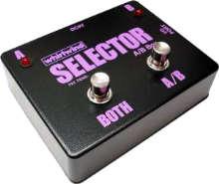

New JavaScript APIs
New selectors
Threading (Web Workers)
UI APIs
Canvas
Drag and Drop
Local and Session Storage
Extension to HTMLDocument

Slide 5

New Selectors

Slide 6
New Selectors
In HTML5 we can select elements by ClassName
Moreover there’s now possibility to fetch elements that match provided CSS syntax
var elements = document.getElementsByClassName('entry');
var elements =
document.querySelectorAll("ul li:nth-child(odd)");
var first_td =
document.querySelector("table.test > tr > td");

Slide 7
New Selectors (2)
Selecting the first div met
Selecting the first item with class SomeClass
Selecting the first item with id someID
Selecting all the divs in the current container
var elements = document.querySelector("div");
var elements = document.querySelector(".SomeClass");
var elements = document.querySelector("#someID");
var elements = document.querySelectorAll("div");

Slide 8

Canvas JavaScript API
How to Manipulate Canvas Dynamically?

Slide 9
Canvas
Canvas
Dynamic, Scriptable rendering of 2D images
Uses JavaScript to draw
Resolution-dependent bitmap
Can draw text as well
<canvas id="ExampleCanvas" width="200" height="200">
This text is displayed if your browser does not support
HTML5 Canvas.
</canvas>
var example = document.getElementById('ExampleCanvas');
var context = example.getContext('2d');
context.fillStyle = "rgb(255,0,0)";
context.fillRect(30, 30, 50, 50);

Slide 10
Canvas Properties and Methods
fillStyle
Sets the drawing color
Default fillStyle is solid black
but you can set it to whatever you like
fillRect(x, y, width, height)
Draws a rectangle
Filled with the current fillStyle

Slide 11
Canvas Properties and Methods (2)
strokeStyle
Sets the stroke color
strokeRect(x, y, width, height)
Draws an rectangle with the current strokeStyle
strokeRect doesn’t fill in the middle
It just draws the edges
clearRect(x, y, width, height) clears the pixels in the specified rectangle

Slide 12
Canvas Paths
What is a Path?
Something that is about to be drawn
It is not drawn yet
context.beginPath();
context.moveTo(0, 40);
context.lineTo(240, 40);
context.moveTo(260, 40);
context.lineTo(500, 40);
context.moveTo(495, 35);
context.lineTo(500, 40);
context.lineTo(495, 45);

Slide 13

Canvas
Live Demo

Slide 14


Web Workers
Multithreading in JavaScript

Slide 15
What are Web Workers?
API for running scripts in the background
Independently of any user interface scripts
Workers are expected to be long-lived
have a high start-up performance cost and a high per-instance memory cost
Might be partially replaced by Window.setTimeout() function

Slide 16
What are Web Workers? (2)
Workers are separate JavaScript processes running in separate threads
Workers execute concurrently
Workers don’t block the UI
Workers allow you to extract up to the last drop of juice from a multicore CPU
Workers can be dedicated (single tab) or shared among tabs/windows
Workers will be persistent too (coming soon)
They’ll keep running after the browser has quit

Slide 17
What are Web Workers? (3)
If we call function by setTimeout, the execution of script and UI are suspended
When we call function in worker, it doesn’t affect UI and execution flow in any way
To create Worker, we put JavaScript in separate file and create new Worker instance:
We can communicate with worker using postMessage function and onmessage listener
var worker = new Worker(‘extra_work.js');

Slide 18
What are Web Workers? (4)
Messages are sended to all threads in our application:
main.js:
var worker = new Worker(‘extra_work.js');
worker.onmessage = function (event) { alert(event.data); };
extra_work.js:
//do some work; when done post message.
// some_data could be string, array, object etc.
postMessage(some_data);

Slide 19
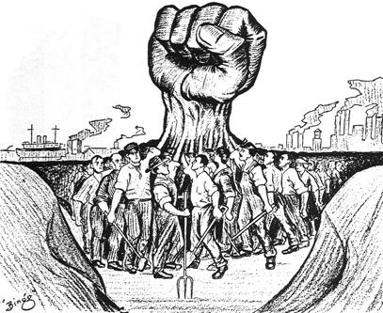
Web Workers
Live Demo

Slide 20

Drag and Drop
Drag and Drop, Local and Session Storage

Slide 21
Drag and Drop
Drag and Drop
<element> attribute draggable="true"
Events: dragstart, dragstop, dragenter, dragleave, dropend

Slide 22
Drag And Drop
Live Demo

Slide 23

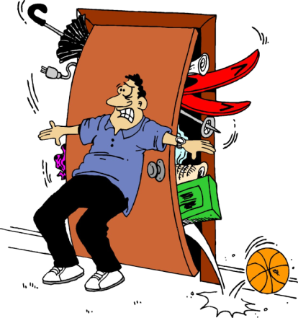

HTML5 Storage
Local and Session

Slide 24
Local Storage
Local Storage
Store data locally
Similar to cookies, but can store much larger amount of data
Same Origin Restrictions
localStorage.setItem(key, value)
localStorage.getItem(key)
Local and Session Storages can only store strings!

Slide 25
Local Storage Example
Local Storage
function saveState(text){
localStorage["text"] = text;
}
function restoreState(){
return localStorage["text"];
}
Same as
function saveState(text){
localStorage.setValue("text", text);
}
function restoreState(){
return localStorage.getValue("text");
}

Slide 26
Session Storage
Session
Similar to Local Storage
Lasts as long as browser is open
Opening page in new window or tab starts new sessions
Great for sensitive data (e.g. banking sessions)

Slide 27
Session Storage Example
Session Storage
function incrementLoads() {
if (!sessionStorage.loadCounter) {
sessionStorage["loadCounter"] = 0;
}
var currentCount =
parseInt(sessionStorage["loadCounter"]);
currentCount++;
sessionStorage["loadCounter"] = currentCount;
document.getElementById("countDiv").innerHTML =
currentCount;
}

Slide 28


HTML5 Storages
Live Demo

Slide 29
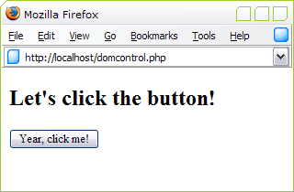

HTML DOM Extensions

Slide 30
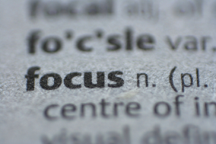
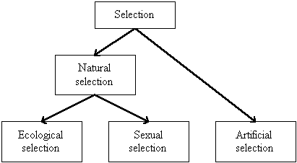
HTML DOM Extensions
HTML DOM Extensions:
getElementsByClassName()
innerHTML
hasFocus
getSelection()

Slide 31
HTML DOM Extensions
Live Demo

Slide 32

Event Listeners
How to Listen for Something to Happen?

Slide 33
Event Listeners
Event Listener is an event that tracks for something to happen
i.e. a key to be pressed or a mouse click, etc.
Available in JavaScript
addEventListener() registers a single event listener on a single target.
The event target may be
A single node in a document
the document itself
a window

Slide 34


Registering Event Listener Example
Adding a click event listener to a div element
document.GetElementById("someElement").
addEventListener("click",
function (e) {
alert("element clicked");
}, false);

Slide 35
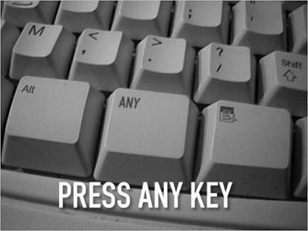
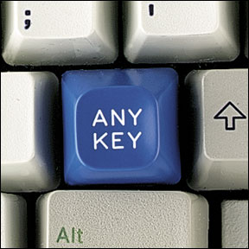
Event Listeners
Live Demo

Slide 36
HTML5 New JavaScript APIs
?
?
?
?
?
?
?
?
?
?
http://academy.telerik.com

Slide 37
Exercises
Write wrapper function as follows: $(ID) to return either a single element, whose ID is the one passed or null $$(selector) to return an array of elements or empty array with results; Use mapping to existing DOM methods e.g. getElementByClassName, querySelectorAll

Slide 38
Exercises
Write an event delegate function member of the Event global object e.g. Event.delegate("selector", "eventName", handlerName) using the previously written functions to match selectors. Map the global listeners to the document or body element; Use w3c style events.

